Slide 1
Tools for Geometric Pattern Recognition
Pattern Recognition 2015/2016
Marc van Kreveld

Slide 2
Topics this lecture
Data conversion
Geometric structures
Voronoi diagrams
Delaunay triangulation
Gabriel graph, relative neighborhood graph
Alpha-shape
Topological structures
Alpha-complex
Persistence diagram

Slide 3
Geometric structures: Voronoi diagram
Versatile geometric structure that captures nearest data information
Basic version for point data
Generalized version for other objects than points
Variations for second-, third-closest points, etc.
Different metrics possible

Slide 4
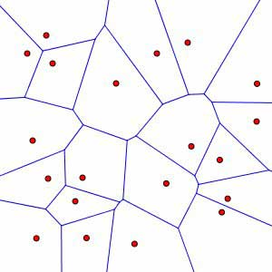
Geometric structures: Voronoi diagram
For a set of points, subdivision of the plane into regions where a specific point of the set is the closest one
On boundaries between regions, more than one point is closest

Slide 5
Geometric structures: Voronoi diagram
Fundamental property: empty-circle property
a Voronoi edge corresponds to centers of circles where the same two points of the set are closest, so no point lies inside
a Voronoi vertex is closest to at least three points

Slide 6
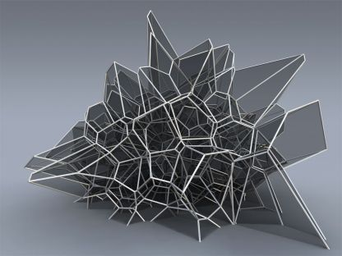
Geometric structures: Voronoi diagram
Voronoi diagram of points in 3D

Slide 7
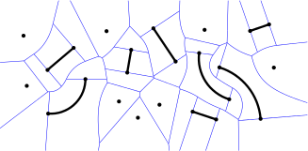
Geometric structures: Voronoi diagram
Generalized Voronoi diagram; sites are not just points

Slide 8
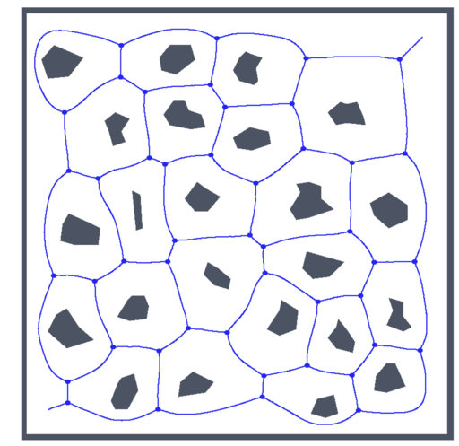
Geometric structures: Voronoi diagram
Generalized Voronoi diagram; sites are not just points
Voronoi edges are straight or parabolic when sites are piecewise straight

Slide 9
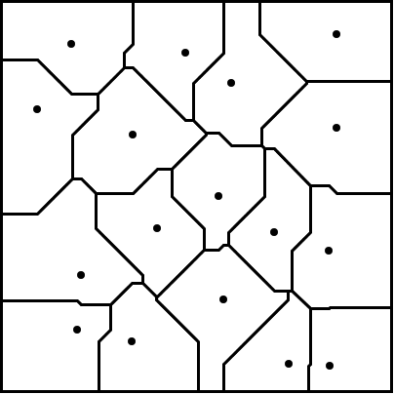
Geometric structures: Voronoi diagram
Voronoi diagram of points in the Manhattan (or L₁) metric
All edges are horizontal, vertical, or diagonal (slope +1 or -1)

Slide 10
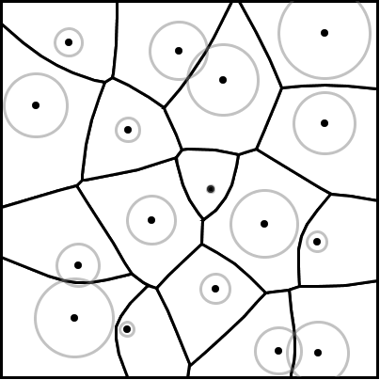
Geometric structures: Voronoi diagram
Additively weighted Voronoi diagram; the weight of a site is shown by the size of the circle centered on it (almost the same as the Voronoi diagram of the circles)
Voronoi edges are hyperbolic
Notes:
Not the same when circles intersect. In particular, a circle inside another circle does not have a cell at all.

Slide 11
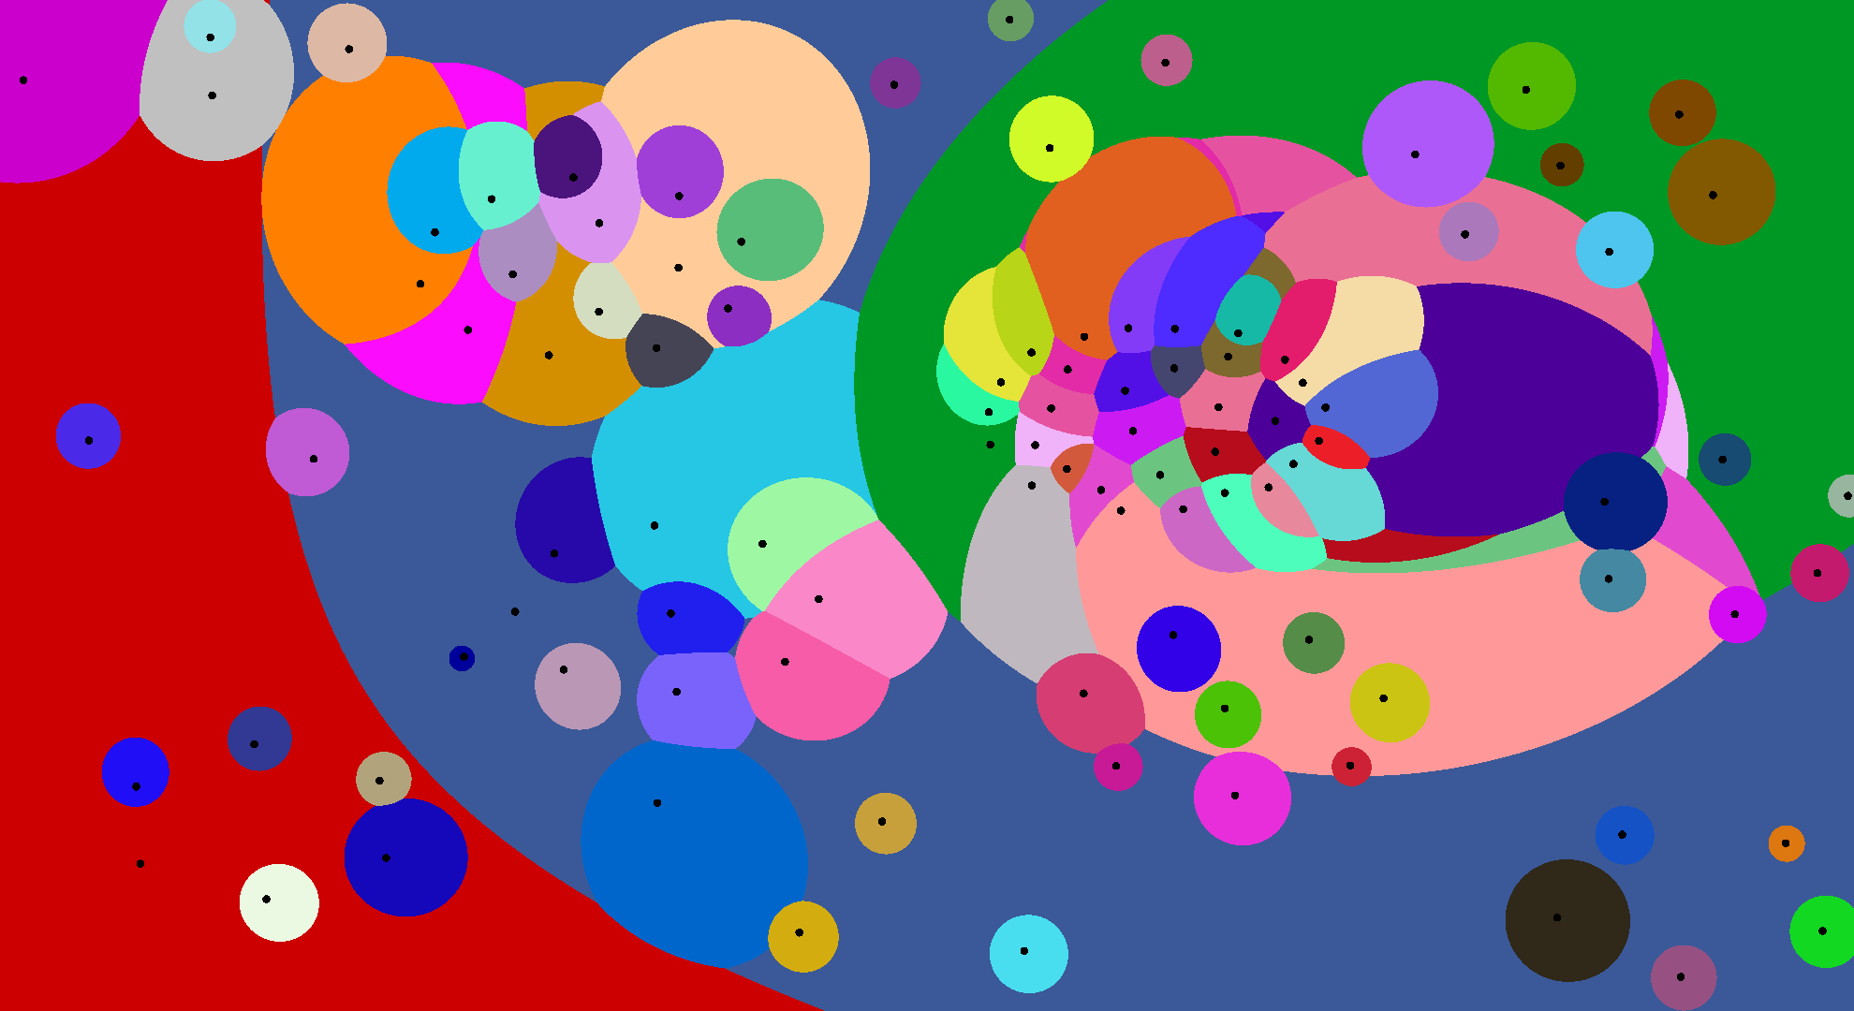
Geometric structures: Voronoi diagram
Multiplicatively weighted Voronoi diagram

Slide 12
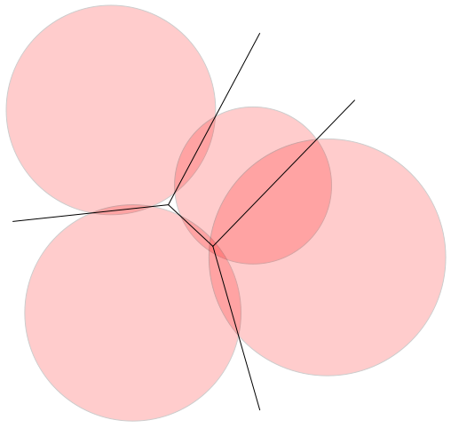
Geometric structures: Voronoi diagram
Power diagram; the power distance between a site s with power r (radius of circle corresponding to s) and a point p is defined as d_{Power}(s,p) = d_{E}(s,p)² – r²
Imagine a site (x,y) with power r to lie in 3D at (x,y,√(K-r²)), and consider the Voronoi diagram in z = 0 using Euclidean distance (K big)

Slide 13
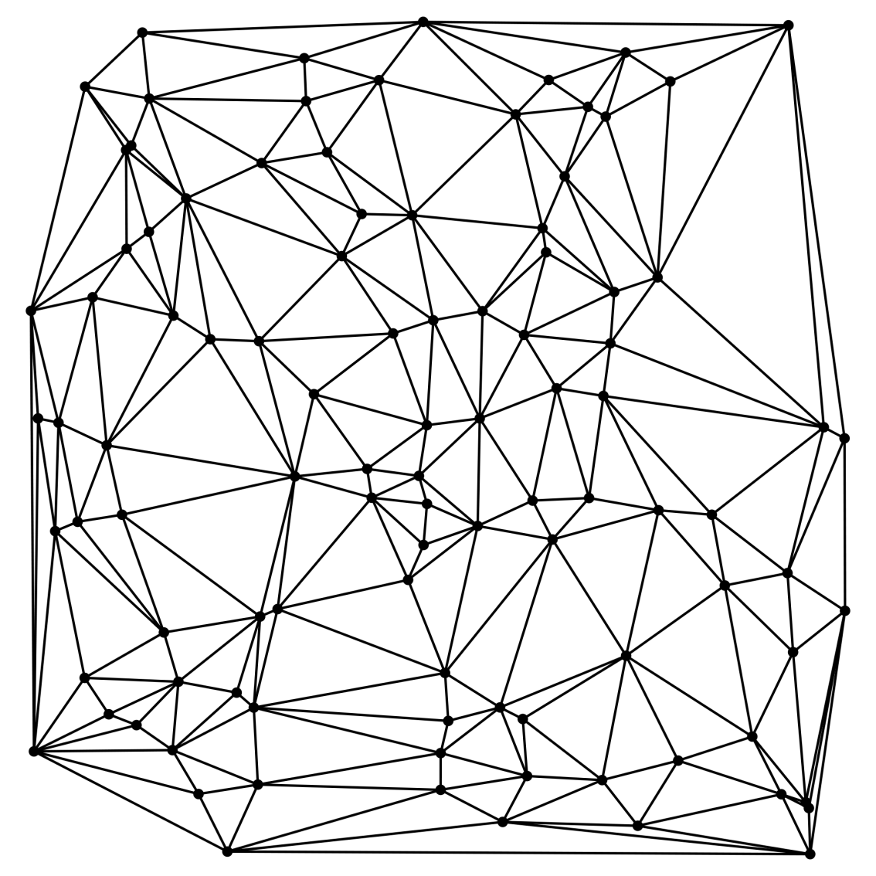
Geometric structures: Delaunay triangulation
Straight-line graph on the given points where all bounded faces are triangles

Slide 14
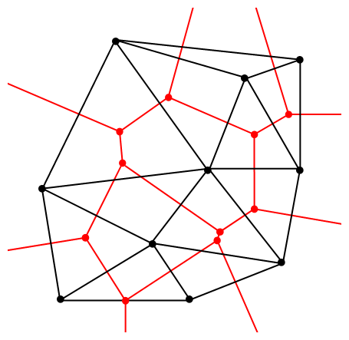
Geometric structures: Delaunay triangulation
Straight-line dual of the ordinary Voronoi diagram: two points are connected if and only if their Voronoi cells share an edge
The Delaunay triangulation inherits the empty circle property by duality from the Voronoi diagram

Slide 15
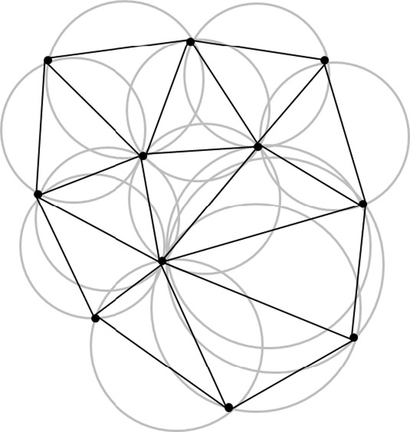
Geometric structures: Delaunay triangulation
In particular, the circumcircle of every triangle is empty (and conversely, if three points have an empty circumcircle, they define a Delaunay triangle)

Slide 16
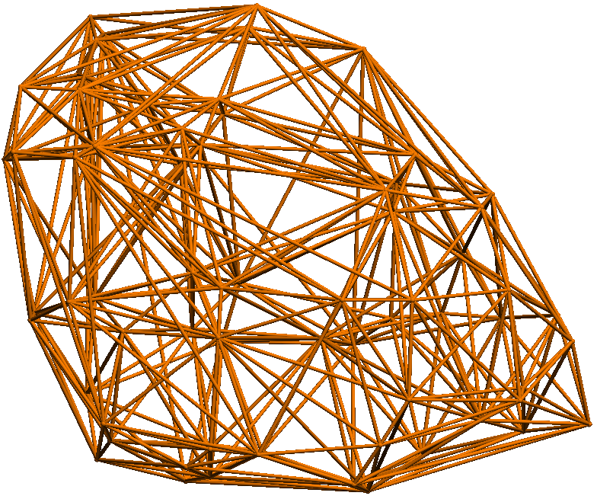
Geometric structures: Delaunay triangulation
Delaunay triangulations exist for points in 3D, but all of the Voronoi diagram variations do not have duals that are triangulations

Slide 17
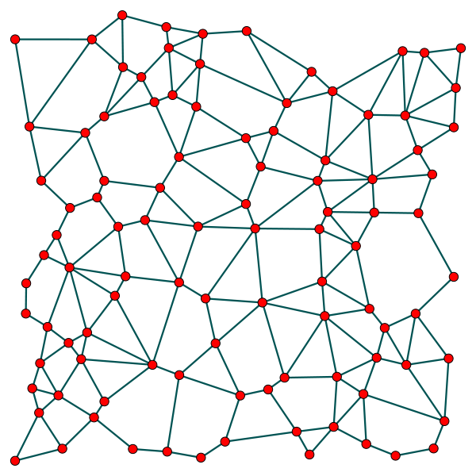
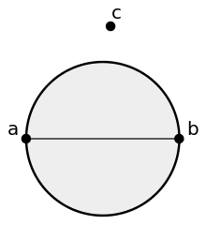
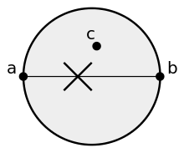
Geometric structures: Gabriel Graph
Subgraph of the Delaunay triangulation, two points are connected if and only if the diametric circle between the points is empty

Slide 18
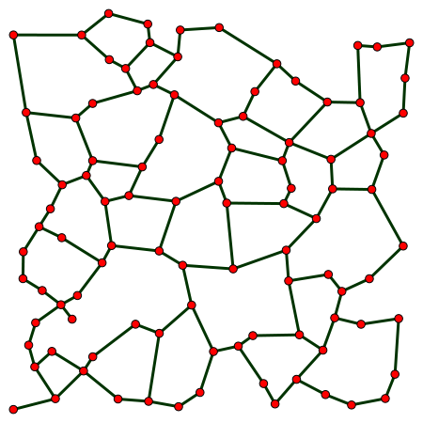
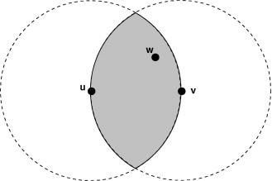
Geometric structures: Relative neighborhood graph
Subgraph of the Delaunay triangulation, two points are connected if and only if the “lune” between the points is empty

Slide 19
The α-shape
The α-shape is a general shape descriptor for a set of points [ Edelsbrunner, Kirkpatrick, Seidel 1983]

Slide 20
The α-shape
The α-shape is the straight-line graph with the α-extreme points as the vertices and the α-neighbors as the edges
α-neighbors
radius α-disk
α-extreme point

Slide 21
The α-shape
Every α-shape edge is also a Delaunay triangulation edge (it has an empty circle through its endpoints)
α-neighbors
radius α-disk
α-extreme point

Slide 22
The α-shape
The choice of α is important
bigger α: avoids holes and separate components in shape, but also less detail
smaller α: more detail but risk of holes and separate components
How to determine the right α?
Can we make α adaptive: smaller where point density is higher and larger where point density is lower?

Slide 23
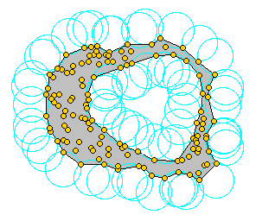
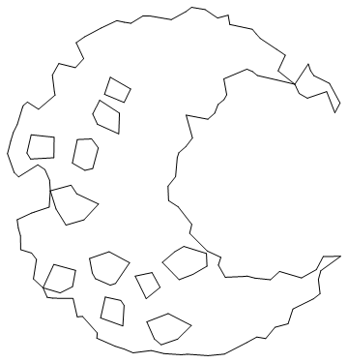
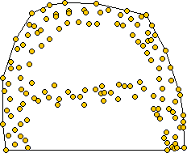
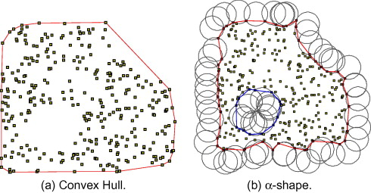
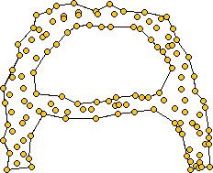
α-shapes

Slide 24
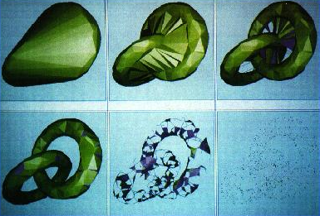
α-shapes in 3D

Slide 25
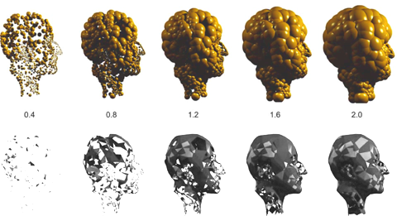
α-shapes in 3D

Slide 26
The α-shape
We can compute the 2D α-shape from the Delaunay triangulation by testing every edge: determine the radius of the smallest and largest empty circle through its endpoints
Circles containing p and q have their centers on the bisector of p and q
p
Empty circles containing p and q have their centers between the centers of the circumcircles of the two triangles incident to edge pq
q

Slide 27
The α-shape
p
largest
q
p
This center realizes the smallest circle
This center realizes the smallest circle
q
largest

Slide 28
The α-shape
The 2D α-shape can be computed from a given Delaunay triangulation on n points in just O(n) time (assuming the Delaunay triangulation is stored in a suitable triangle mesh representation!)
From the points: O(n log n) time is possible

Slide 29
The α-shape in 3D
In 3D everything is analogous:
Triangles of the α-shape are defined by empty balls of radius α
These triangles occur in the Delaunay tetrahedrilization
For any triangle in the Delaunay tetrahedrilization, the centers of balls through its vertices lie on a line and we can decide in O(1) time whether a triangle occurs in the α-shape by inspecting the two incident tetrahedra (their circumspheres)
Notes:
The efficiency of computing the 3D alpha shape is worse than for 2D alpha shapes, because the 3D Delaunay tetrahedrilization can have quadratic complexity

Slide 30
Topological structures
Structures that focus on connectivity and changes in connectivity rather than exact geometry
Based on (mathematical) topology (homology)
Important for shape analysis and data analysis
Allow to distinguish noise from features in data

Slide 31
Topological structures: alpha-complex

Slide 32
Topological structures: alpha-complex

Slide 33
Topological structures: alpha-complex

Slide 34
Topological structures: alpha-complex

Slide 35
Topological structures: alpha-complex

Slide 36
Topological structures: alpha-complex

Slide 37
Topological structures: alpha-complex

Slide 38
Topological structures: alpha-complex
When the disks grow at the same rate:
Two touching disks create an edge between their centers, unless this edge intersects another edge
A loop of touching disks creates a cycle in the graph
A triple of touching disks creates a triangle, if the three edges are in
When the disks are very large, we obtain all edges and triangles of the Delaunay triangulation
The process also works for disks of different radii and the power distance

Slide 39
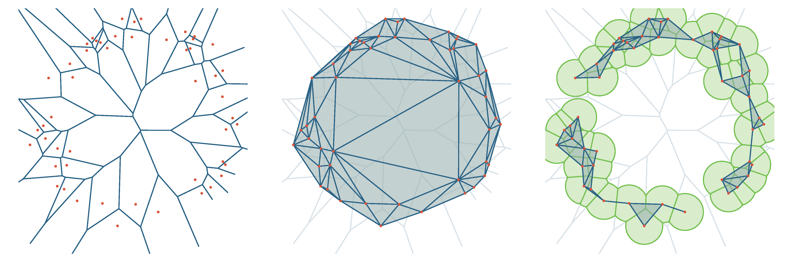
Topological structures: alpha-complex

Slide 40
Topological structures: alpha-complex
Consider the Voronoi diagram inside the union of the disks
Then two points are connected if they share a piece of Voronoi edge inside this union of disks
Three points make a triangle if the Voronoi vertex is inside the union of disks

Slide 41
Topological structures: alpha-complex
We are interested in the connection events and their order
This loop is formed for some radius, and closed for a much bigger radius
This loop is formed for some radius, and closed for a slightly bigger radius
closed = filled by triangles

Slide 42
Topological structures: alpha-complex
The importance (persistence) of a loop is the size of the radius range in which it lives:
Short-lived loops are caused by noise or sampling
Long-lived loops are features of the shape
death
0
radius
birth

Slide 43
Topological structures: alpha-complex
When a loop L is formed and then splits into two loops: loop L lives on the in the longest living subloop
Also when a loop shrinks a bit, it lives on
death
L
birth

Slide 44
Topological structures: alpha-complex
By using a cut-off for the life length of a loop, we can extract the important loops and therefore get the topology of a shape
cut-off
death
0
radius
birth

Slide 45
Topological structures: alpha-complex
By using a cut-off for the life length of a loop, we can extract the important loops and therefore get the topology of a shape
real features
noise
death
persistence diagram
birth

Slide 46

Topological structures: alpha-complex

Slide 47
Topological structures: alpha-complex

Slide 48
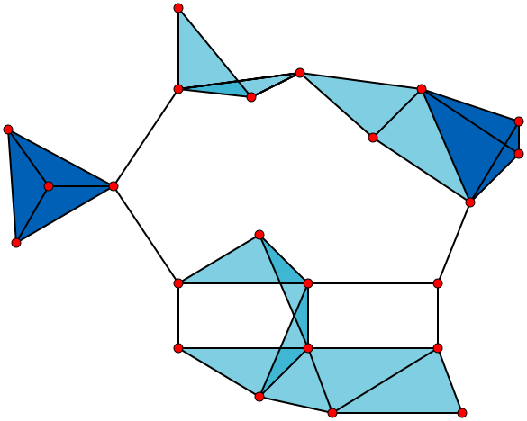
Topological structures: persistence
The idea of applying persistence is more general than just its application to the alpha-complex: it can be applied to any growth process with structural changes
Cech complex, Vietoris-Rips complex: a k-simplex for every k-fold intersection of disks
Disks may have different radii and growth rates
Notes:
(Matthew Wright) https://www.youtube.com/watch?v=h0bnG1Wavag
(Gunnar Carlsson) https://www.youtube.com/watch?v=XfWibrh6stw

Slide 49
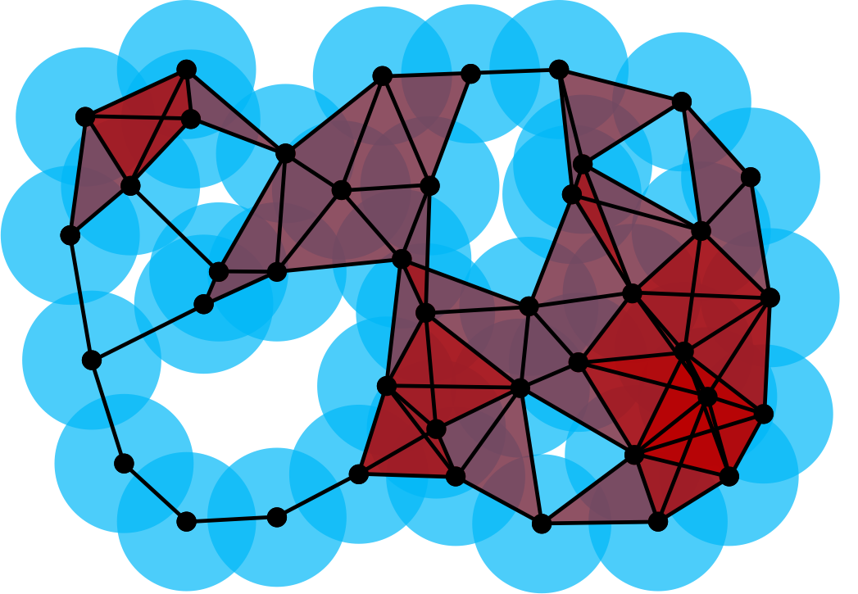
Topological structures: persistence

Slide 50
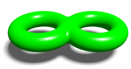
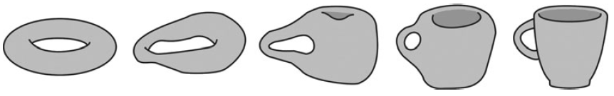
3D shape analysis
3D shapes have components, tunnels and voids
Components grow together by edges
Tunnels may be created by an addition of an edge and may be destroyed by filling in triangles
Voids (open space inside a solid) may be created by an addition of a triangle and may be destroyed by filling in tetrahedra

Slide 51
Shape and data analysis
An analysis of components, tunnels and voids, and persistence, can be applied to any growth process in 3D
It can distinguish noise and features in real-world data
In 3D and higher-D, there are more applications to data analysis than only shape analysis
Notes:
https://en.wikipedia.org/wiki/Topological_data_analysis

